Slide 1


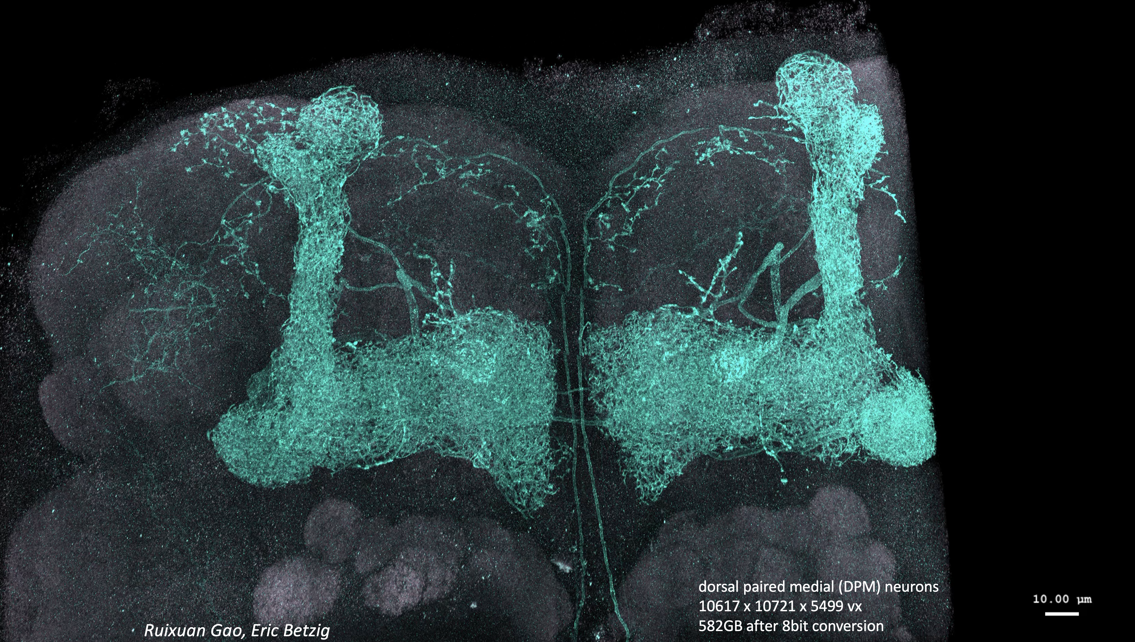
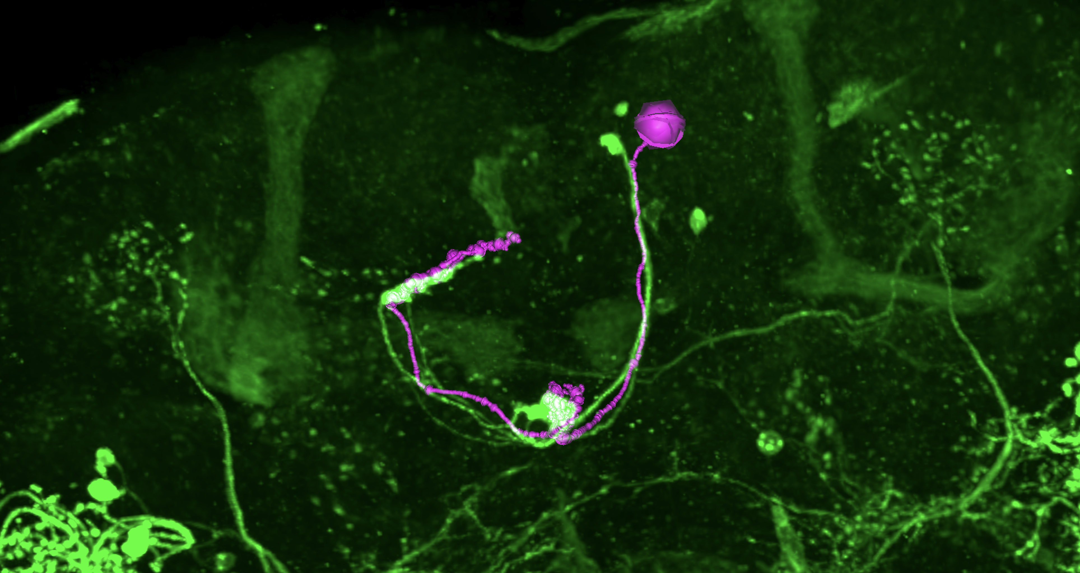
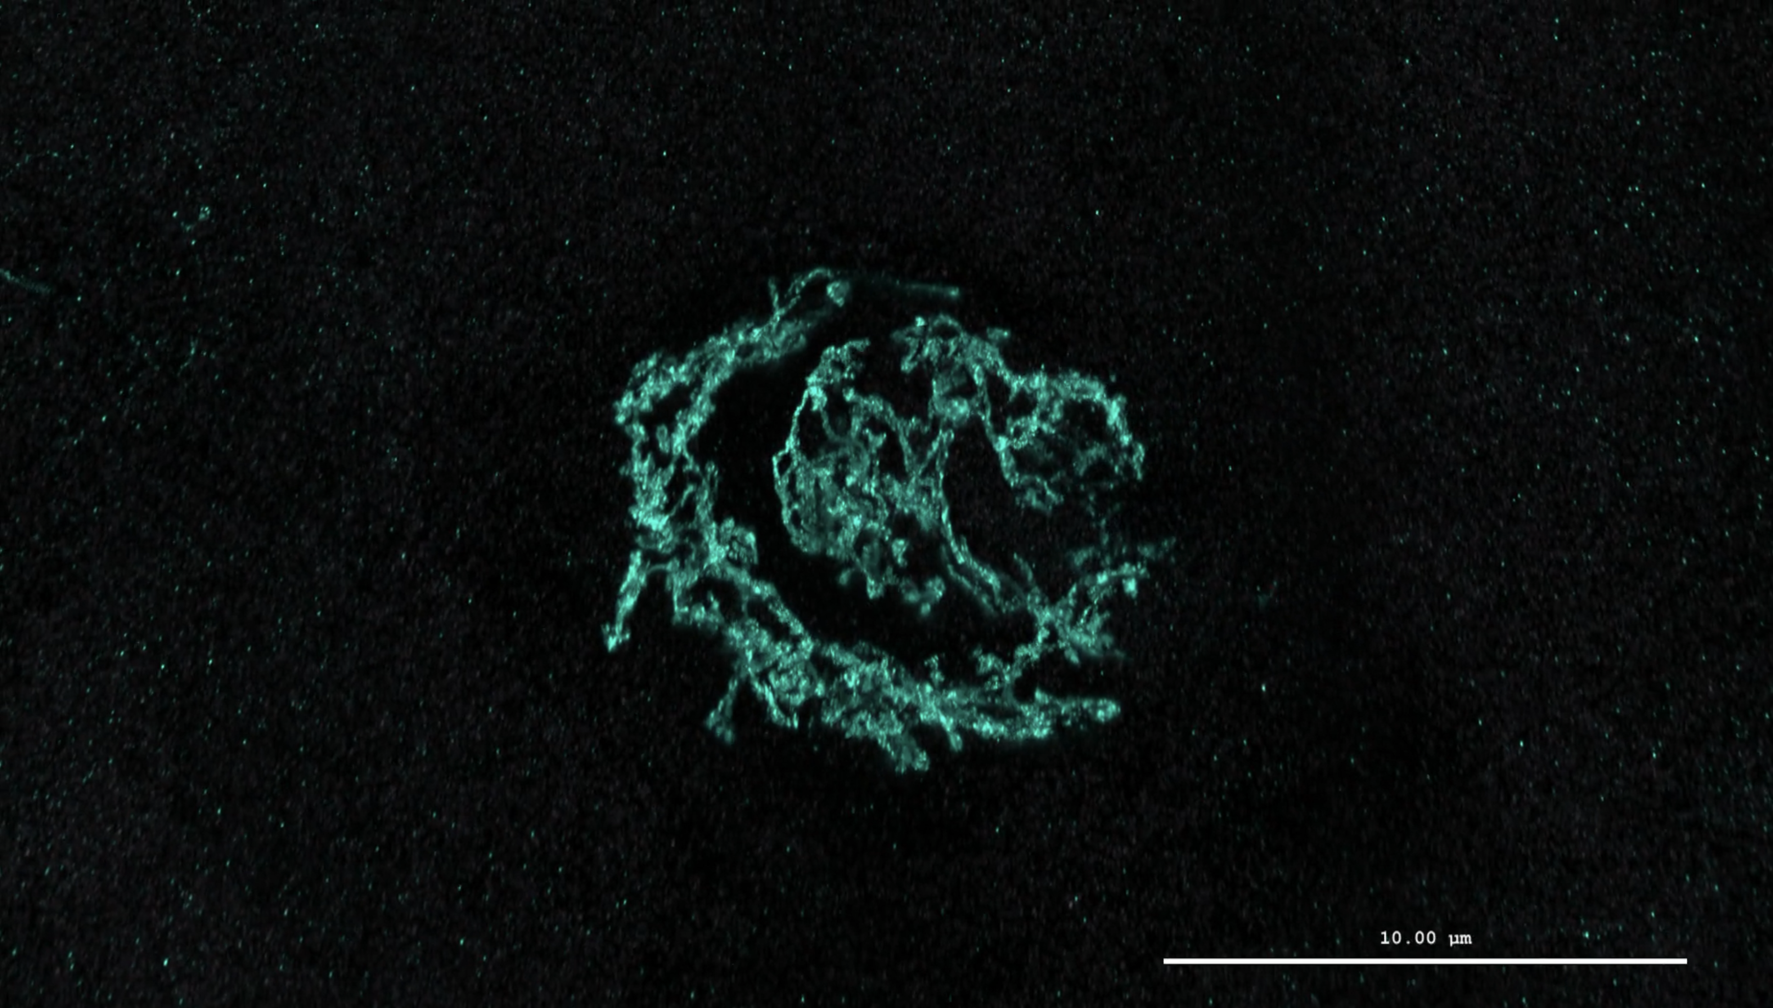
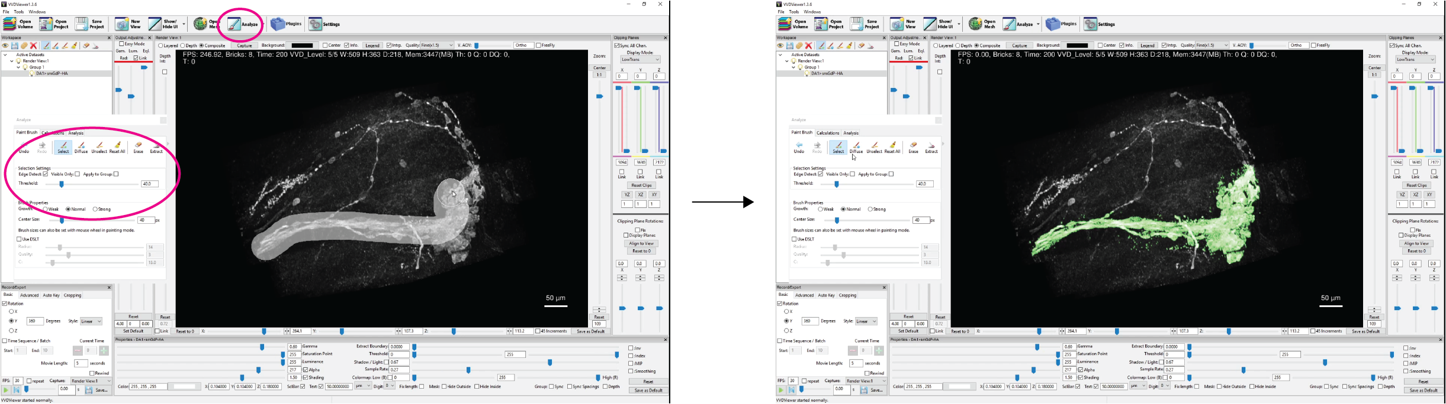
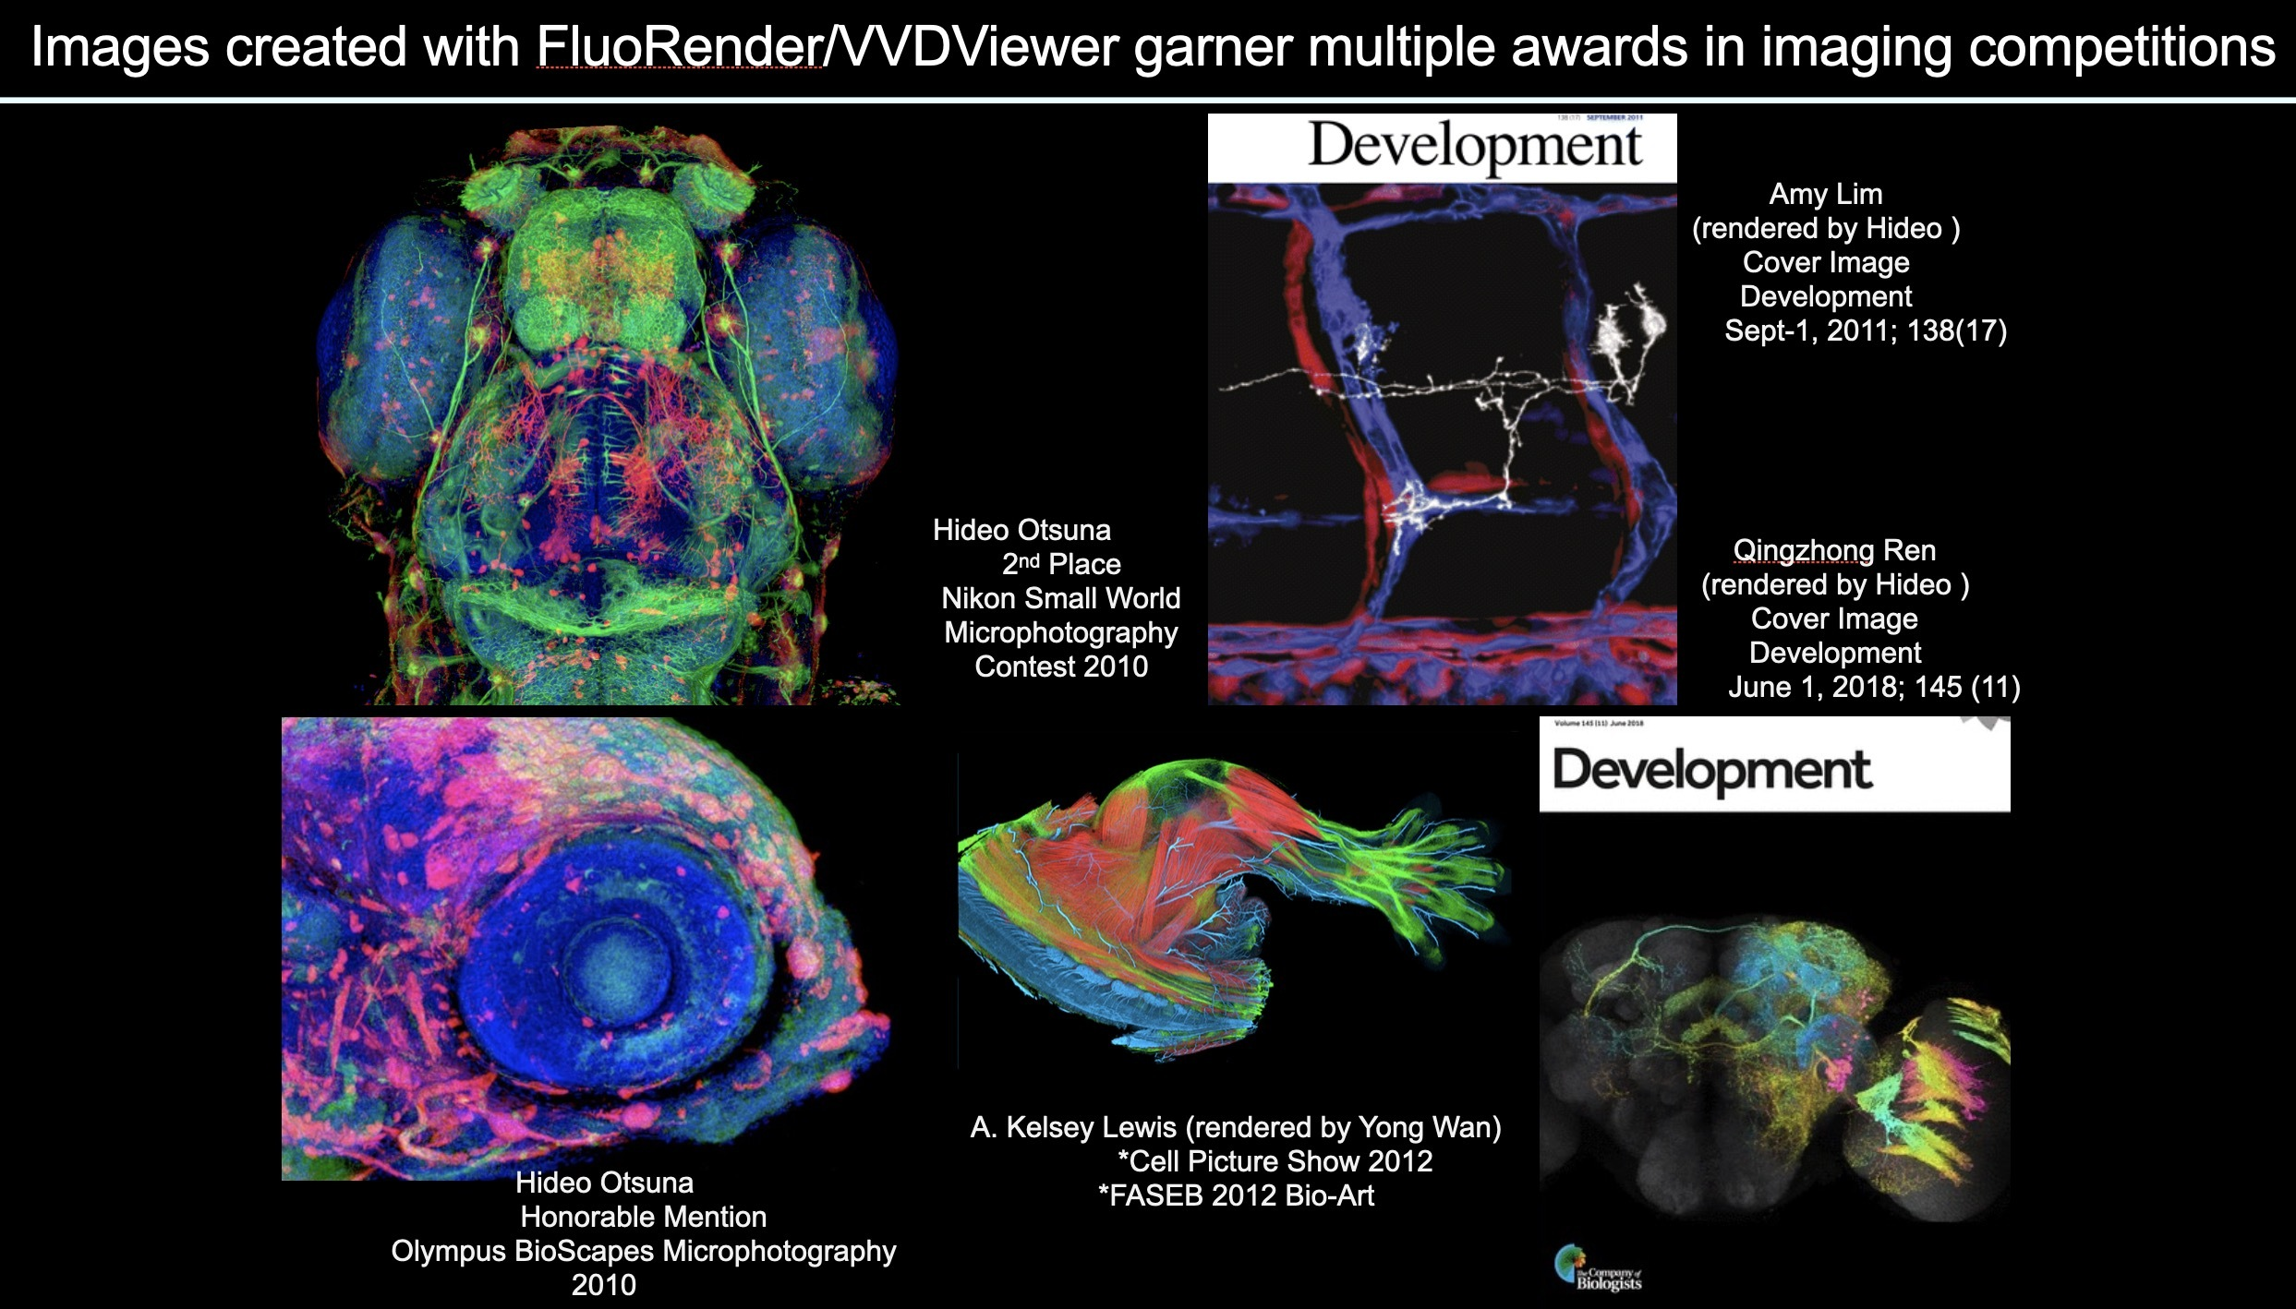
Exploring the VVDViewer: Volume Visualization and Analysis
Takashi Kawase and Hideo Otsuna
Janelia Research Campus
Manual and download link
VVDViewer is an open-source software developed by Janelia Research Campus for intuitive 3D/4D volume visualization, segmentation, and analysis. It’s engineered to manage large volumetric datasets, such as Expansion Microscopy (ExM), ideal for multi-channel light microscopy users across various operating systems including macOS, Windows, and Linux. VVDViewer’s capabilities extend to exporting images and simplifying movie creation, enhancing the dissemination of research findings and the development of visual materials for presentations and publications.
We can customize VVDViewer as you need!
ExM Resolution Pyramid Rendering
EM LM Visualization
FlyLight
FlyEM
Green: LM volume, Magenta: EM skeleton (mesh)
The VVDViewer integrates the visualization of both EM meshes and LM volumes within a single view. This feature greatly enhances the analytical experience by providing a comprehensive perspective of the data in an interactive environment.
The VVDViewer supports multi-resolution pyramids, adept at handling terabyte-scale volume datasets. This remarkable capability allows for a seamless expansion of visualization from the macroscopic view of entire tissues down to the intricate details of synapses. This enhanced functionality ensures a comprehensive and detailed exploration of volumetric data.
3D Volume Segmentation
Competition Winning Images
Josh Lillvis
The VVDViewer offers an innovative 3D painting feature within its 3D view, enabling users to interact directly with 3D objects. This tool facilitates the rapid segmentation of hundreds of slices within a minute. Additionally, it provides the flexibility to either extract or remove selected objects with precision.
4D Image Visualization
The VVDViewer can render high quality images. The VVDViewer, a fork of Fluorender, distinguishes itself by utilizing the Vulkan graphics API, in contrast to Fluorender's reliance on the traditional OpenGL framework. This shift to Vulkan enables the VVDViewer's volume renderer to achieve a remarkable speed advantage, operating at a pace 3 to 4 times faster than Fluorender and VTK, both of which are based on OpenGL. This enhancement also significantly improves efficiency in processing and visualizing large-scale volumetric data.
Timepoint 1
Timepoint 78
Timepoint 139
A complex choreography of cell movements shapes the vertebrate eye. K. M. Kwan*, H. Otsuna*, H. Kidokoro, K. R. Carney, Y. Saijoh, C.-B. Chien Development 2012
The VVDViewer is adept at rendering multi-channel 4D datasets. It utilizes a multi-threaded approach to load timepoints, which significantly enhances the efficiency and speed of data processing. This feature allows for a smoother and more rapid visualization experience, particularly beneficial when dealing with large and intricate datasets.

